Slide 1

Walking patterns recognition under real world conditions
Russo, Nastastic, Cernigliaro, Broniarek, Alliende

Slide 2

Main research aim
Main goal: verify if there are different patterns of walking among the group members of this project.
Secondary goals:
To make Francesco walk more than 10 minutes at once
Perform a multi-resolution analysis: analyze if the elicitation of the length of the window selected to divide the data affects the results of the classification

Slide 3

Overview
Test Set Error
Training Set Error
Data Collection
Data preprocessing
Bins size 1
Bins size 2
Bins size 3
Feature generation
Feature generation
Feature generation
Random Forest
LDA
Naive Bayes
Multiclass Logistic
Random Forest
LDA
Naive Bayes
Multiclass Logistic
Random Forest
LDA
Naive Bayes
Multiclass Logistic

Slide 4
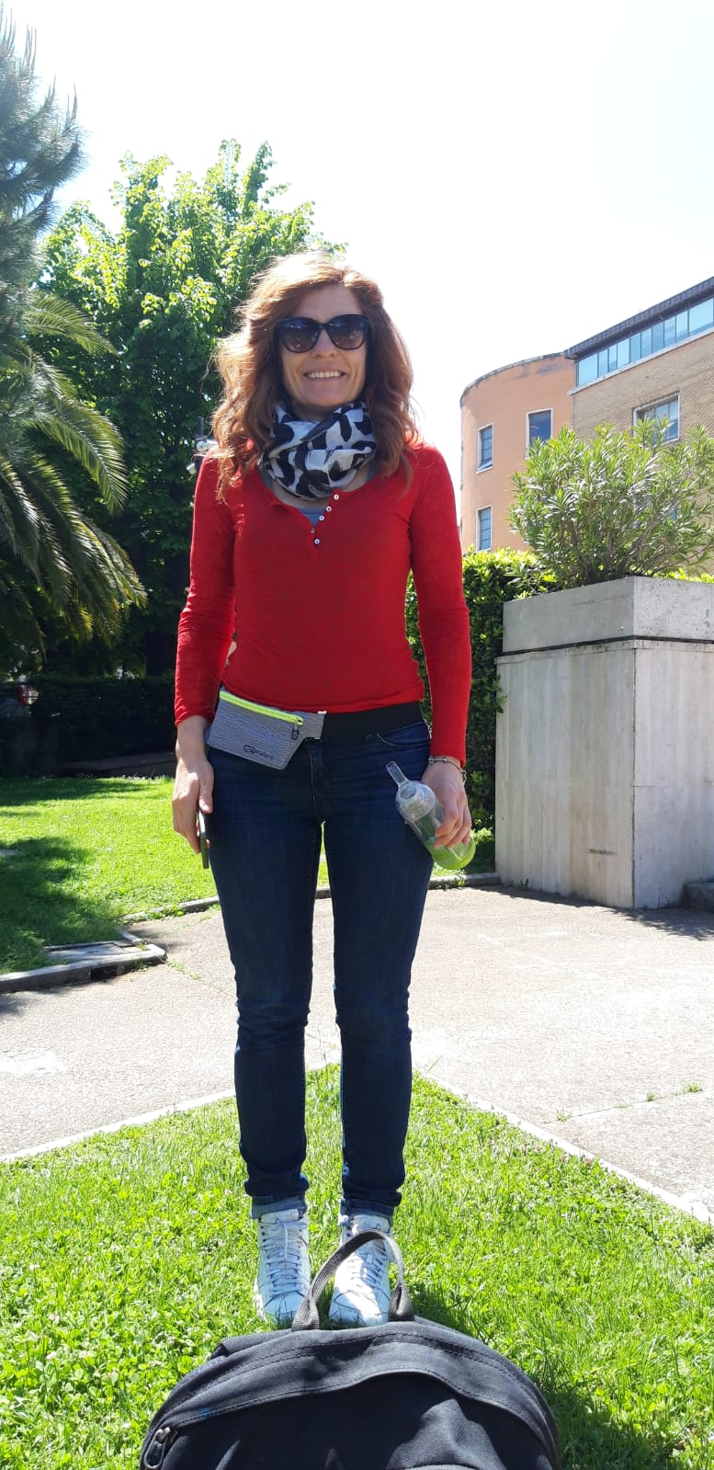
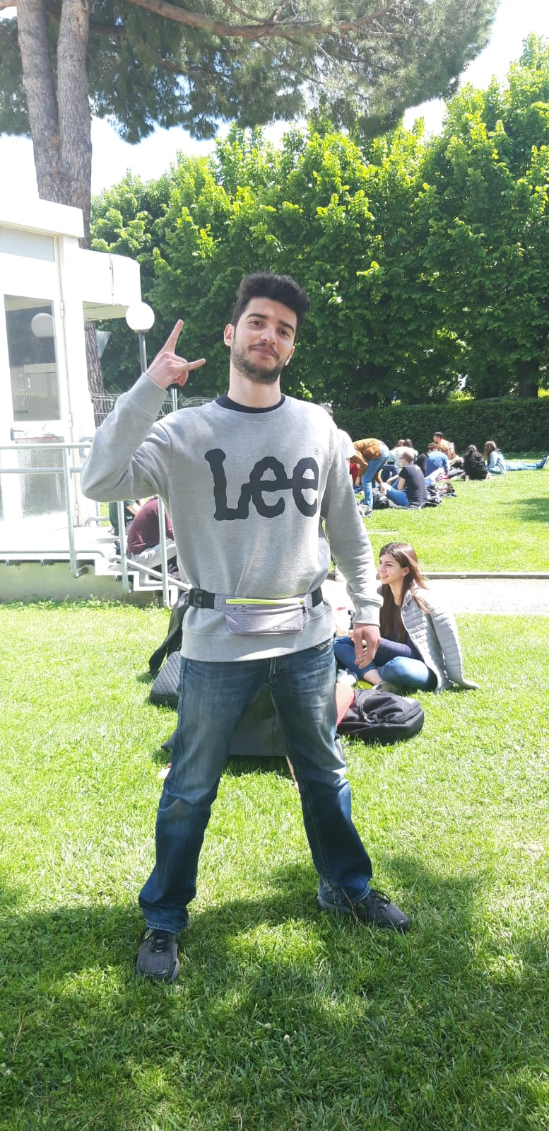
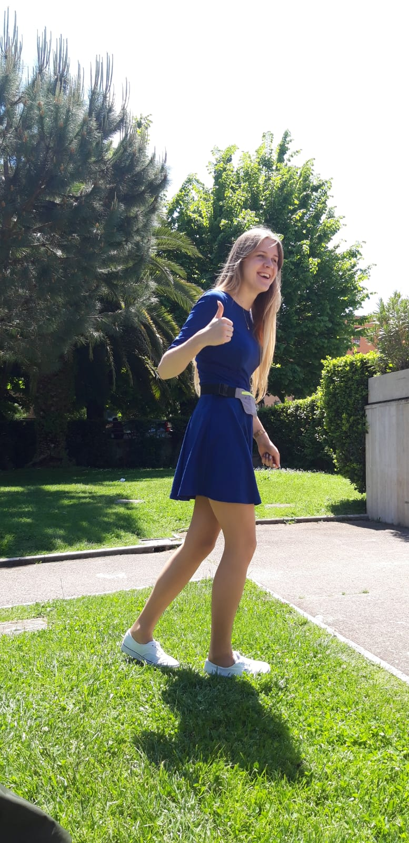
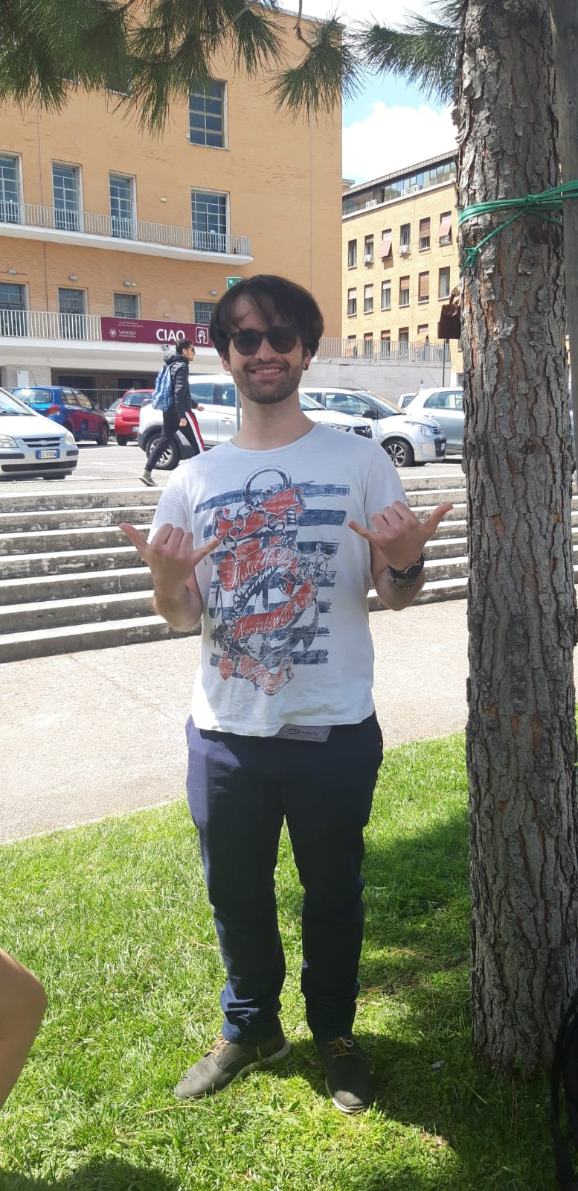
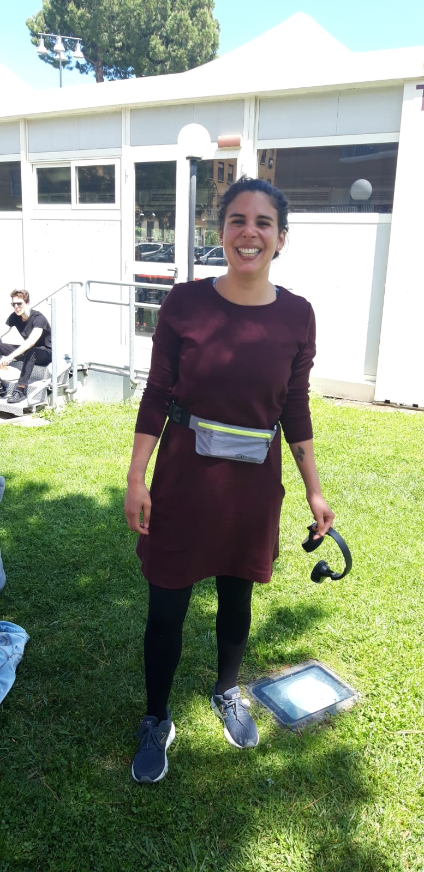

Data collection

Slide 5

The Data
5 files, one for each person of the group
15 minutes of recording
Initial features:
Linear Accelerometer Sensor
Acceleration on the x axis
Acceleration on the y axis
Acceleration on the z axis

Slide 6

Data Pre-processing
Dealing with noisy data:
Removed 1 minute on the beginning and 1 minutes on the end of each record
Filtering the data: low-pass and high-pass filter
Dealing with null-values
Time bins → Multiresolution Analysis
Window size
Overlap
Features generation

Slide 7
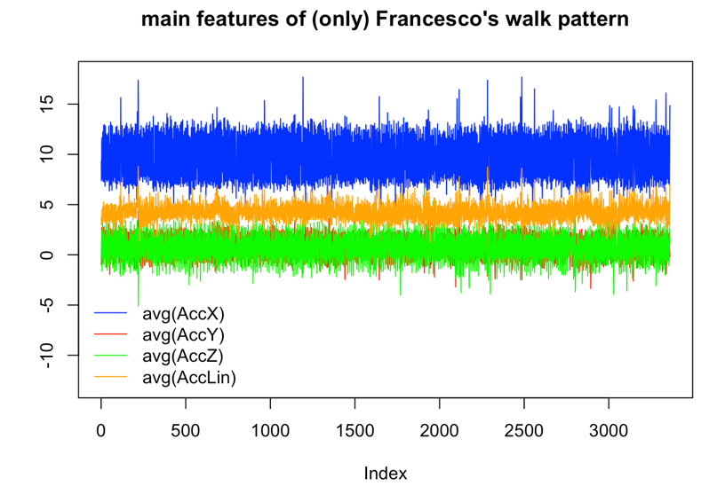

Features generation

Slide 8


Model elicitation
Super mega giga iper deeep machine Classificat networks neural Bayesian SKLearning Model

Slide 9

Model elicitation
Random Forest
Train error: 9.319
Train error:
SVM
Naive Bayes
Train error:
…
Train error
Test error: 9.093
Test error:
Test error:
Test error

Slide 10

Conclusions

